Slide 2
Person p1 = new Person(); p1.name = "Tome"; p1.isMale = true; System.out.println(p1.name); Person p2 = new Person(); System.out.println(p2.name); Person p3 = p1; p3.age = 10;
0x7788
name: null
age: 1(已赋值)
isMale: false
0x12ab
name: null→Tom
age: 1(已赋值)→10
isMale: false→true
P3: 0x12ab
P2: 0x7788
P1: 0x12ab
栈：stack
堆：heap

Slide 3
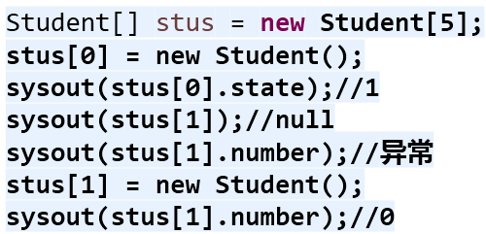
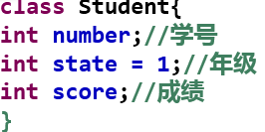
0x1122
0x2233
0 | null
1 | null
2 | null
3 | null
4 | null
0x2233
number: 0
state: 0→1
score: 0
number: 0
state: 0
score: 0
status
0x1122

